Slide 1
From Data to Semantics: Automated Aspect Model Creation and Knowledge Graph Integration for Digital Twin
Nazanin Mashhaditafreshi
06.02.2025
Supervisors:
Dr.-Ing. habil. Achim Wagner,
M.Sc. Pascal Rübel,
Dr. Andreas Textor,
M.Sc. Nastaran Moarefvand

Slide 2
Overview
Introduction
Motivation & Research Questions
Methodology
Results
Limitations & Future Work
Conclusion

Slide 3
Introduction
Semantic Aspect Meta Model (SAMM) and Asset Administration Shell (AAS) are designed to standardize and enhance data interoperability, particularly within Industry 4.0.
SAMM:
A core component of the Eclipse Semantic Modelling Framework.
RDF-based metamodel that semantically describes data within the digital twin.
Explicitly supports semantic definitions, including units of measurement, and models constraints (ranges, regular expressions, etc.).
Rich tooling for generating additional artifacts.
AAS:
The digital representation of an industrial asset.
Describes semantic via semantic ID
Enables standardized data exchange using JSON, XML, RDF/Turtle formats.
Java Code
JSON Schema
Aspect Model
OpenAPI Spec
AAS Submodel Template
HTML Doc

Slide 4
Introduction
Asset Administration Shell (AAS):
A standardized solution for creating digital twins of industrial assets, addressing interoperability through:
Common modeling structure (AAS Metamodel)
Standardized data exchange formats (JSON, XML, RDF/Turtle)
Eclipse Semantic Modeling Framework (part of the Eclipse Digital Twin project):
Semantically describes aspects via an RDF-based metamodel, called
Semantic Aspect Meta Model (SAMM)
Allows to express semantic such as Units, and model constraints (ranges, regular expressions, etc.)
Rich tooling to generate side artifacts:
AAS Submodel to Aspect model & vice versa
Java code generator
HTML document with diagram
Example JSON payload
Java Code
JSON Schema
AAS Submodel Template
Aspect Model
OpenAPI Spec
HTML Doc
Notes:
REST API for data manipulation
Open-source tooling (Eclipse Digital Twin Project)

Slide 5
AAS vs SAMM
Asset Administration Shell (AAS):
Express the digital twin of an asset.
Structure (Submodel) and runtime data (value) together
Meaning of the elements via semantic ID
No formal way to handle constraints and units (via custom qualifiers)
Semantic Aspect Meta Model (SAMM):
Describes the data within a digital twin.
Explicit and formal way to express constraints and units
SAMM Aspect Model does not contain data but describes it.

Slide 6
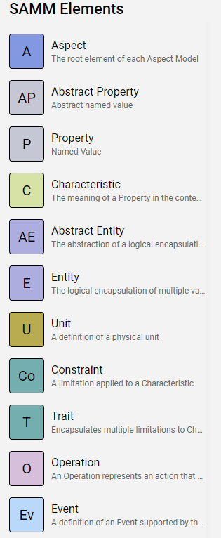
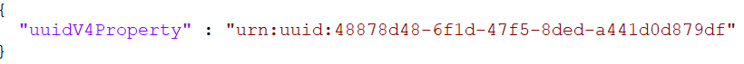
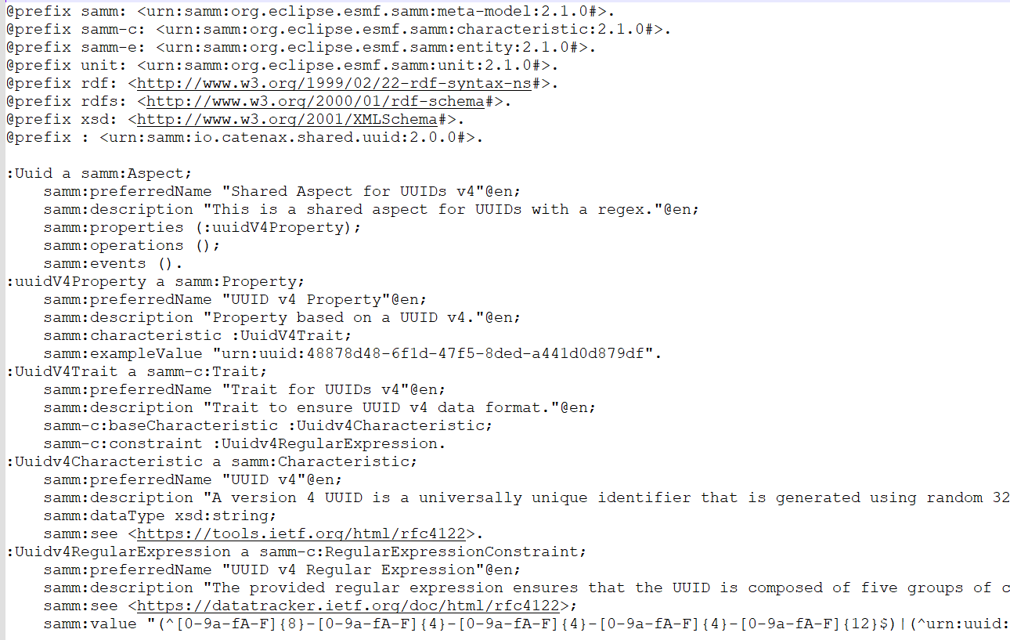
Example of SAMM Aspect Model
JSON Payload
RDF/Turtle

Slide 7
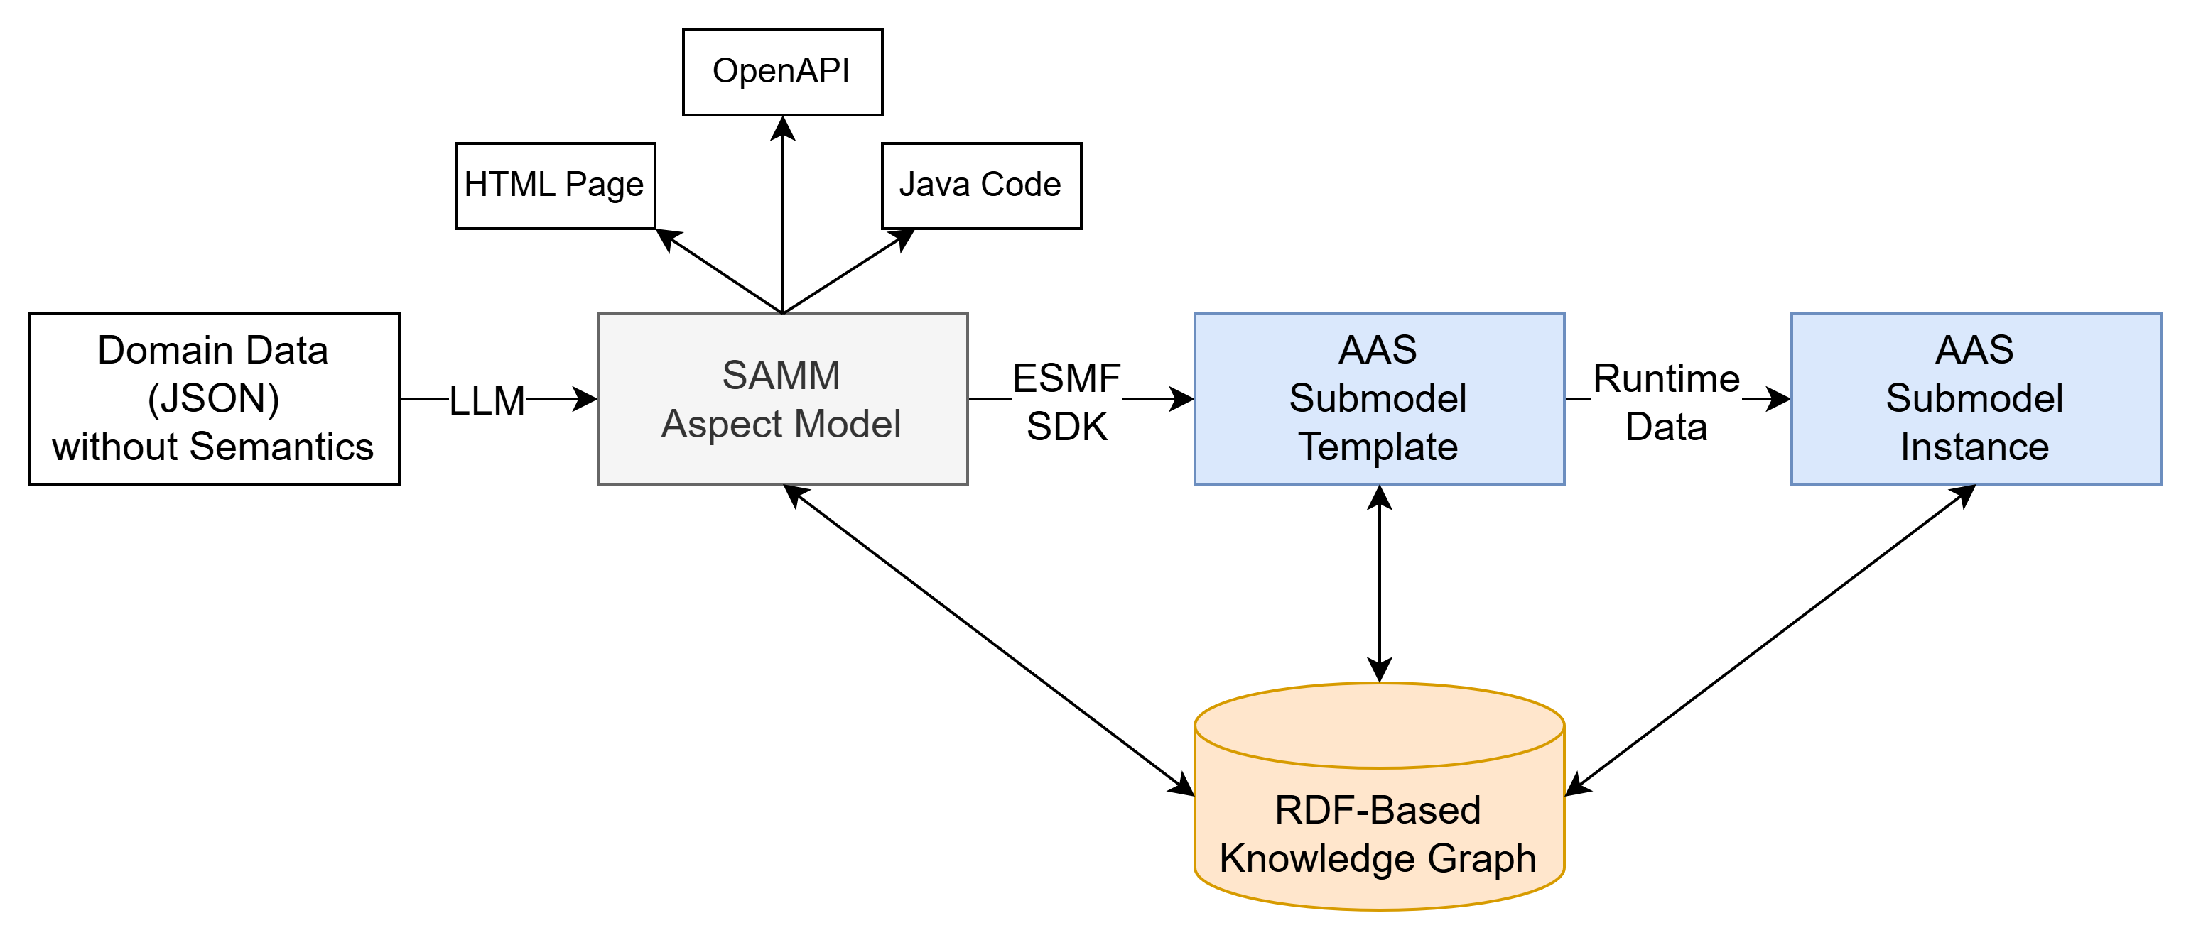
Motivation
Problem
Creating SAMM Aspect Model or AAS Submodel for existing assets
Requires modeling expertise
Needs domain knowledge
Is hard and time consuming
Our Solution
Automate the process of generating Aspect models from existing JSON data

Slide 8
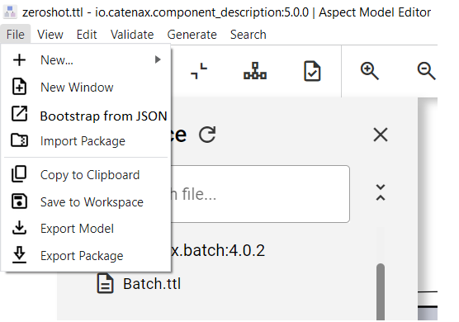
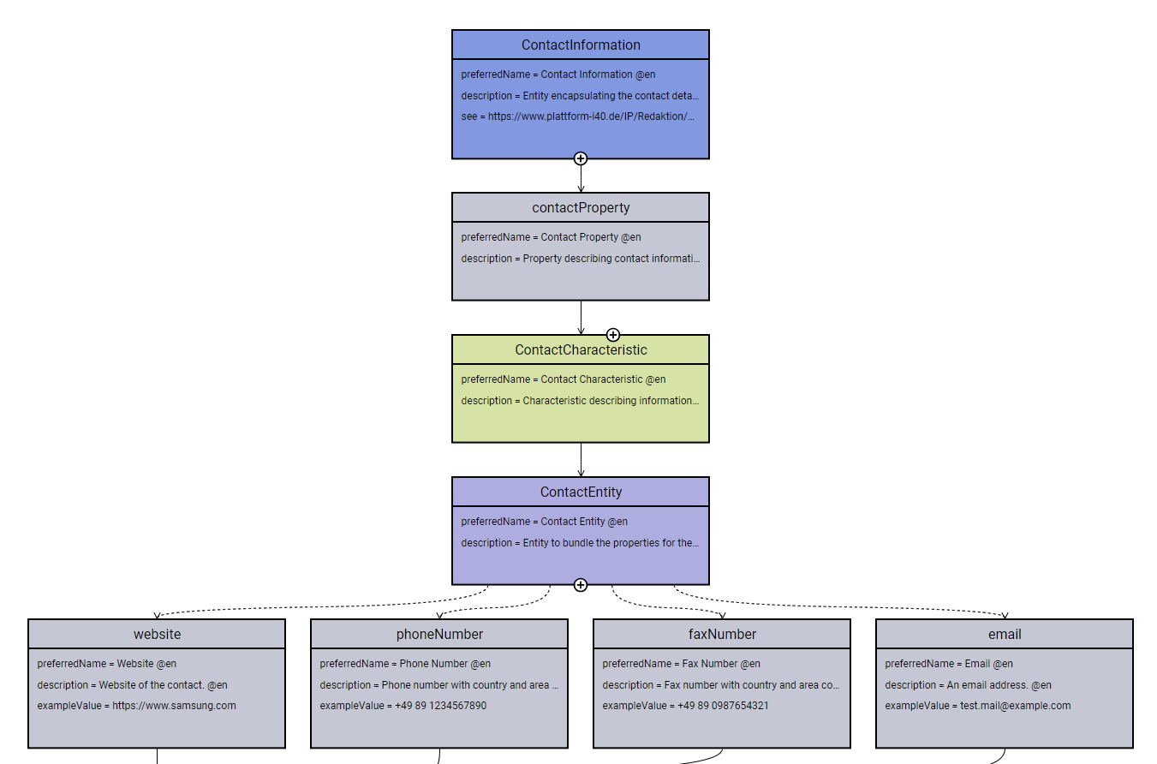
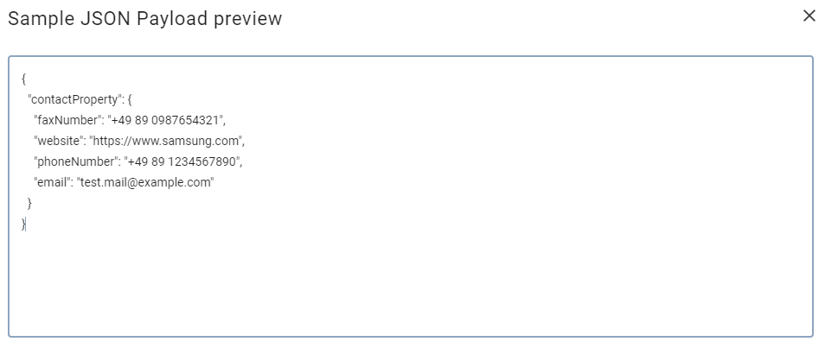
End Goal
LLM generates
User gives an example

Slide 9
Research Questions
RQ1: How can existing domain data in JSON format be leveraged to automatically or semi-automatically derive the basic structure of Aspect Models within SAMM?
RQ2: How do open-source LLMs compare to commercial solutions, such as OpenAI’s models, in generating Aspect Models?
RQ3: What automated methods can be developed to evaluate the Aspect Models generated by LLMs?
RQ4: To what extent can data augmentation techniques improve the accuracy of LLMs when creating Aspect Models from domain data?
RQ5: How can an LLM be integrated into various end-user tools and workflows, including but not limited to an Aspect Model Editor, to help domain experts?
RQ6: How can SAMM and AAS be integrated to form a Knowledge Graph-based digital twin for enhanced data interoperability and decision-making?

Slide 10
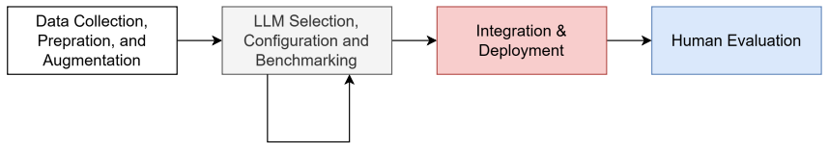
Methodology
Data Preparation
Collection: Aspect Models from Eclipse Tractus-X Semantic Layer (SLDT) GitHub repository
Cleanup: Fix issues in the repository, remove unnecessary data, etc.
Augmentation: Remove and rename properties randomly
Split based on the Aspect Model name
LLM Selection, Configuration, and Benchmarking
Integration & Deployment
Human Evaluation
Notes:
Tractus-X is a project that deals with data exchange and interoperability in automative industry

Slide 11
Methodology
Data Collection, Preparation, and Augmentation
LLM Selection, Configuration, and Benchmarking
Integration & Deployment
Human Evaluation

Slide 12
Data Collection, Preparation and Augmentation
Data Collection:
Aspect Models for Eclipse Tractus-X Semantic Layer (SLDT) GitHub repository contains 100+ high-quality and maintained models in the context of automotive. No other option: Other models are simple models from official documentation or tutorial.
Data Preparation:
Convert old models (BAMM)
Fix issues in the repository
Remove unnecessary data
Migrate to latest SAMM
Data Augmentation:
Rename property
Remove property
Change example values

Slide 13
Final Dataset
Test Data = 20% of Data
Validation Data = 10% of Remaining Data
 | Original-Cleaned Data | Synthetic Data
Train Data | 110 | 241
Validation Data | 13 | 27
Test Data | 32 | 96
Total | 155 | 364

Slide 14
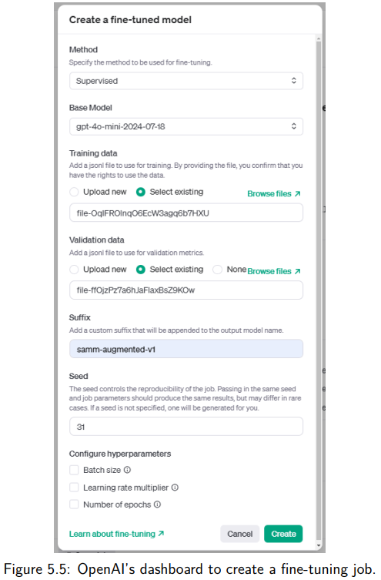
LLM Models and Fine-Tuning
Cloud Fine-Tuning (Azure AI Studio, OpenAI Platform, AWS Bedrock, …)
Low entry cost
Fully managed with various billing options
GPT4o-mini
Local Fine-Tuning (PyTorch, HuggingFace, Unsloth, …) We used Unsloth library for fine-tuning due to its efficiency and lower resource consumptions.
Deployment locally via Ollama
Chat interface via LibreChat, …
Llama3.1-8b, Qwen2.5-Coder-7b, Llama3.2-3b, and CodeLlama-7b

Slide 15
Zero Shot Prompt Template
You are a bot to help people create Semantic Aspect Meta Model (SAMM) from given JSON data. Create SAMM model based on the following JSON:
JSON:
<Domain Data (JSON)>
Provide only the SAMM model without explanation. Make sure you always give a valid RDF turtle as the SAMM model.

Slide 16
Few Shot Prompt Template (One Example)
This is an example SAMM model:
<SAMM Aspect Model (turtle)>
This is its corresponding JSON example:
<JSON Payload of Aspect Model>
Your task is to create a SAMM model from a JSON Example.
Json Example:
<Domain Data (JSON)>
Provide only the SAMM model without explanation, make sure that the output is a valid RDF Turtle format.

Slide 17
Few Shot Prompt Template (Two Examples)
This is an example SAMM model:
<SAMM Aspect Model (turtle) #1>
This is its corresponding JSON example:
<JSON Payload of Aspect Mode #1>
This is an example SAMM model:
<SAMM Aspect Model (turtle) #2>
This is its corresponding JSON example:
<JSON Payload of Aspect Mode #2>
Your task is to create a SAMM model from a JSON Example.
Json Example:
<Domain Data (JSON)>
Provide only the SAMM model without explanation, make sure that the output is a valid RDF Turtle format.

Slide 18
Evaluation
Produce Valid Turtle (Valid Turtle)
Produce Valid SAMM (Valid SAMM)
Generated JSON structurally similar to the input JSON (Correct)
Human Evaluation (Complete)
Compare two JSON Data
Input:
Example JSON
Generate Corresponding JSON
SAMM Aspect Model
LLM
ESMF SDK

Slide 19
Generated Invalid JSON from Output SAMM
Failed to generate JSON structurally similar to the input JSON.
Not Correct (Failed to create “contactProperty” Entity)
{
"contactProperty" : {
"faxNumber" : "+49 89 0987654321",
"website" : "https://www.samsung.com",
"phoneNumber" : "+49 89 1234567890",
"email" : "test.mail@example.com"
}
}
{
"faxNumber": "+49 89 0987654321",
"website": "https://www.samsung.com",
"phoneNumber": "+49 89 1234567890",
"email": "test.mail@example.com"
}
Ground Truth JSON:
Generated JSON from the Predicted SAMM:

Slide 20
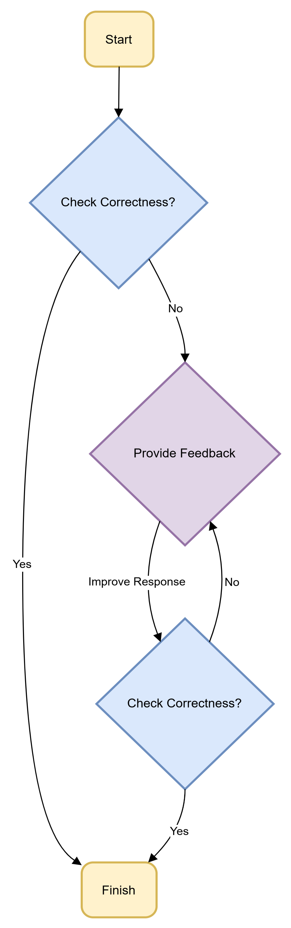
Iterative Prompting
Ask the model to correct itself by providing feedbacks.
Iterative Prompting Template:
In your previous attempt you created this Semantic Aspect Meta Model (SAMM Aspect Model):
<Previous SAMM Aspect Model generated by the LLM>
But it has the following error:
<Previous Error Messages>
Try to fix the error and generate the whole corrected SAMM Aspect Model
without any extra explanation.
<Extra Hints related to the Exception>

Slide 21
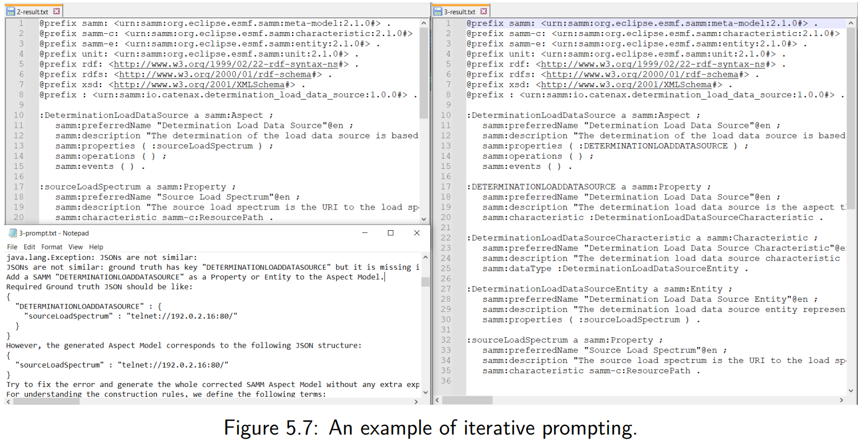
Iterative Prompting Example:

Slide 22
Experiment 1: Effect of Examples and Number of Attempts
Counting the number of metamodel elements used in the Aspect Model, such as Property, Characteristics, Trait, Enumeration, etc.
A more complete example improved the result by 4%.
Increasing the number of attempts improved performance.
Model | Valid Turtle | Valid SAMM | Correct
Simple example Complex example | 84 (87%) 85 (88%) | 34 (35%) 41 (42%) | 28 (29%) 32 (33%)
Model | Attempt 1 | Attempt 2 | Attempt 3
Simple example Complex example | 21 (21%) 27 (28%) | 25 (26%) (+4) 31 (32%) (+4) | 28 (29%) (+3) 32 (33%) (+1)
Simple example: io.catenax.waste
Complex example: io.catenax.secondary_material_content
Notes:
pass@3

Slide 23
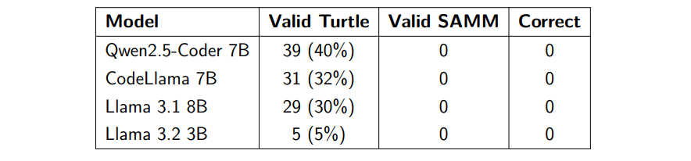
Experiment 2: Comparison of Llama3.1-8b, Qwen2.5-Coder-7b, Llama3.2-3b, and CodeLlama-7b without Fine-Tuning
Code-based LLMs are more capable of generating valid Turtle Aspect Models.
In the absence of SAMM knowledge, they generate arbitrary RDF Turtle statements, but not a valid SAMM Aspect Model.

Slide 24
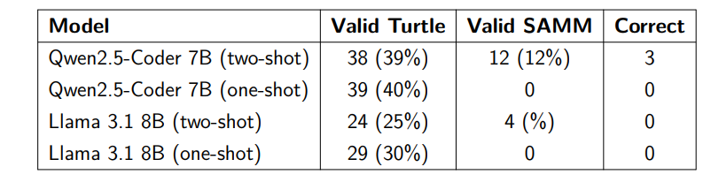
Experiment 3: Effect of More Shots on Qwen2.5-coder-7b and Llama3.1-8b
Two-shot prompting improves the performance of the base LLM compared to one-shot.

Slide 25
Experiment 3: Effect of More Shots on Qwen2.5-coder-7b and Llama3.1-8b
Code-based models are more capable of generating valid Turtle models.
Two-shot prompting improves the performance of the base LLM compared to one-shot.
Model | Valid Turtle | Valid SAMM | Correct
Qwen2.5-Coder 7B (two-shot) | 38 (39%) | 12 (12%) | 3 (3%)
Llama 3.1 8B (two-shot) | 24 (25%) | 4 (4%) | 0
Qwen2.5-Coder 7B (one-shot) | 39 (40%) | 0 | 0
CodeLlama 7B (one-shot) | 31 (32%) | 0 | 0
Llama 3.1 8B (one-shot) | 29 (30%) | 0 | 0
Llama 3.2 3B (one-shot) | 5 (5%) | 0 | 0

Slide 26
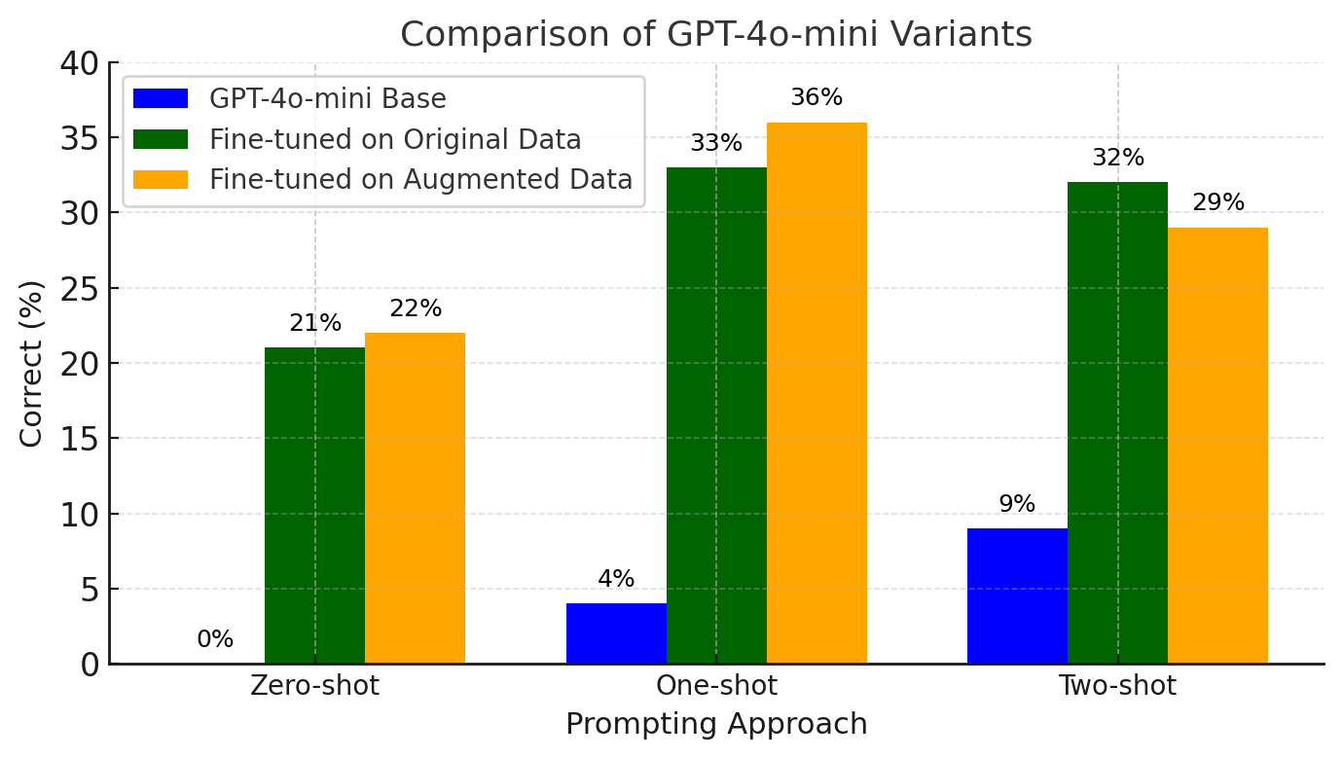
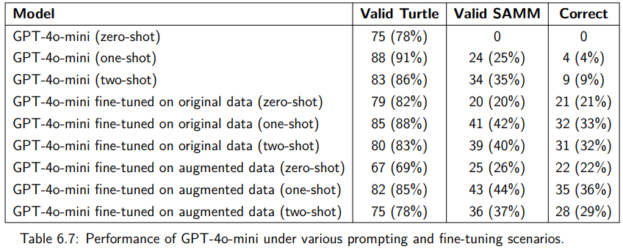
Experiment 4: Comparison of GPT-4o-mini Base, Fine-Tuned on Original Data, and Fine-Tuned on Augmented Data
The augmented dataset improved results by 3% (one-shot) but doubled the training cost.
Our data augmentation introduces minimal variations with simplifying the model, this does not teach new concepts to the LLM.
Notes:
??????

Slide 27
Experiment 4: Comparison of GPT-4o-mini Base, Fine-Tuned on Original Data, and Fine-Tuned on Augmented Data
The augmented dataset improved results by 3% (one-shot) but doubled the training cost.
Our data augmentation introduces minimal variations with simplifying the model, this does not teach new concepts to the LLM.
Notes:
??????

Slide 28
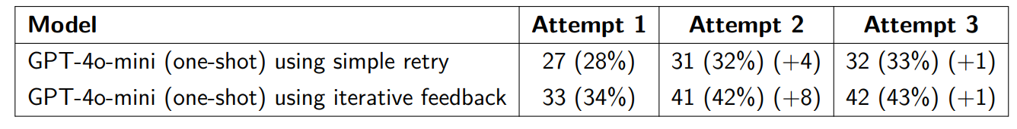
Experiment 5: Iterative Prompting on Fine-tuned GPT-4o-mini
Iterative prompting is more effective than simple retry.
Providing extra information enhances the LLM's performance in iterative prompting.

Slide 29
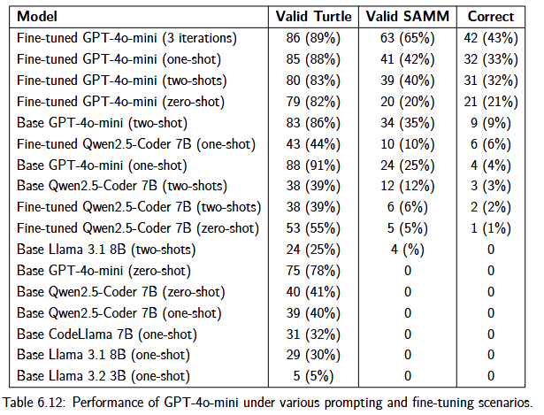
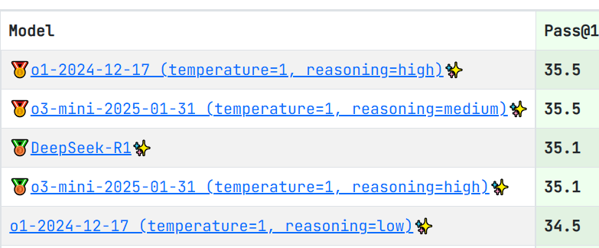
Summary of the Results
Iterative prompting improved performance by 10%.
More shots help base LLMs and confuse fine-tuned LLMs
Zero-shot works only for fine-tuned LLMs.
BigCodeBench (hard code generation tasks)
Source: https://bigcode-bench.github.io/

Slide 30
Summary of the Results
Iterative prompting improved performance by 10%.
More shots help base LLMs and confuse fine-tuned LLMs
Zero-shot works only for fine-tuned LLMs.

Slide 31
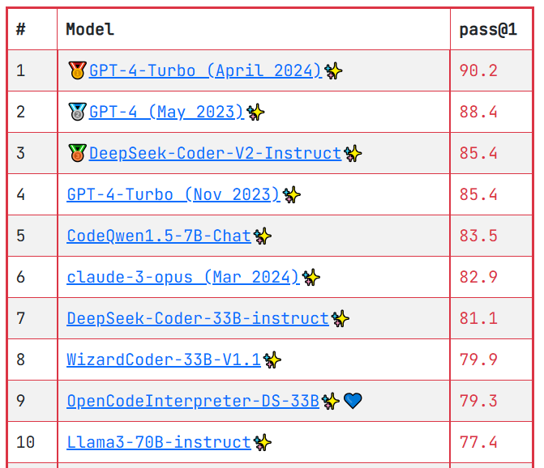
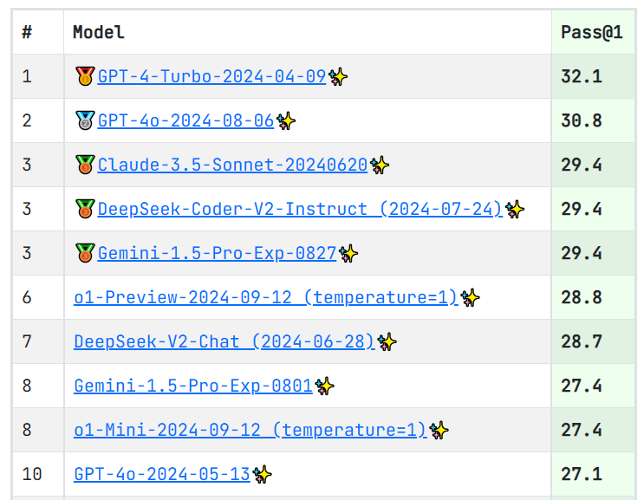
Easy Task vs Hard Task
HumanEval (easy code generation tasks) BigCodeBench (hard code generation tasks)
Source: https://evalplus.github.io/leaderboard.html
Source: https://bigcode-bench.github.io/

Slide 32
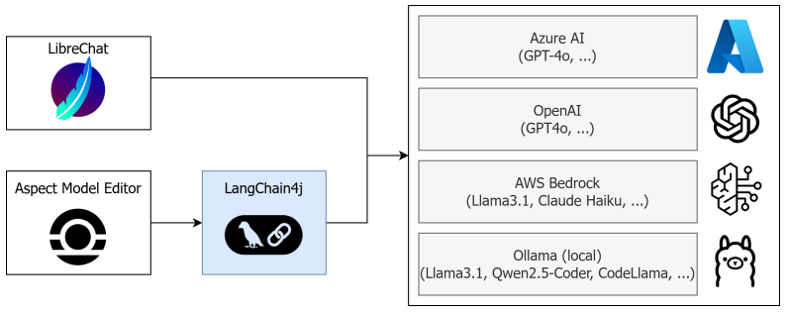

Deployment & Integration

Slide 33
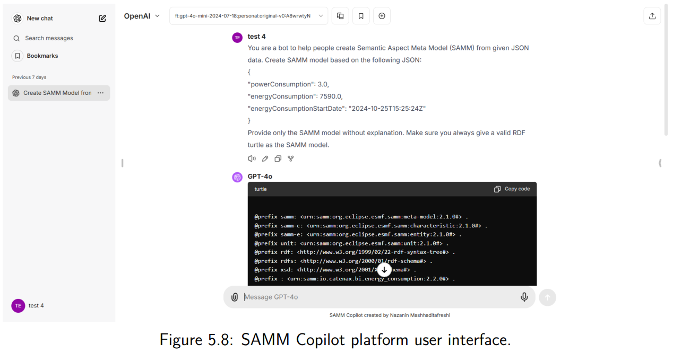
Deployment & Integration: SAMM Copilot Platform User Interface
https://sammcopilot.studio/

Slide 34
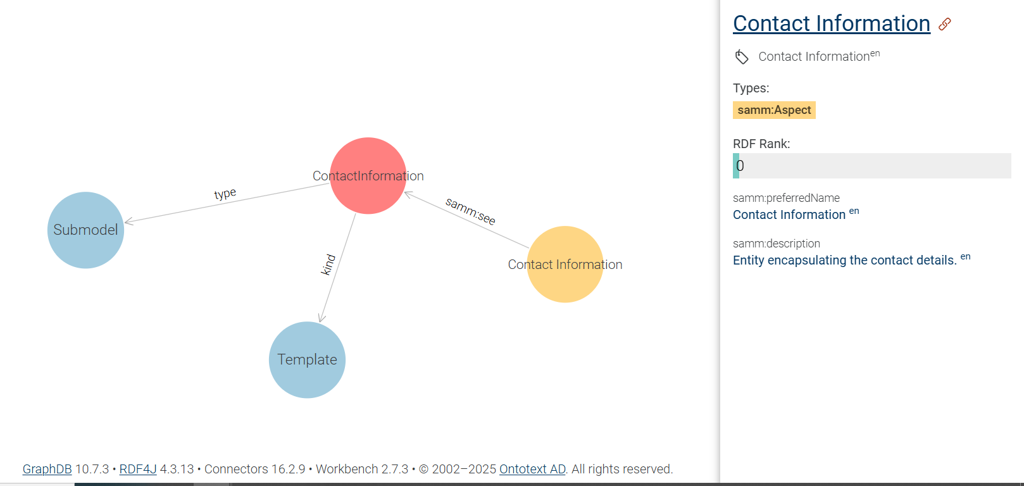
SAMM and AAS in an RDF-based Knowledge Graph
Convert SAMM Aspect Model to AAS Submodel.
Submodel templates/instances are converted to RDF (according to the AAS specification) using an experimental feature in the Eclipse BaSyx Python SDK.
This enables the integration of GenAI and Graph Retrieval Augmented Generation (GraphRAG) for applications such as question answering in future work.

Slide 35
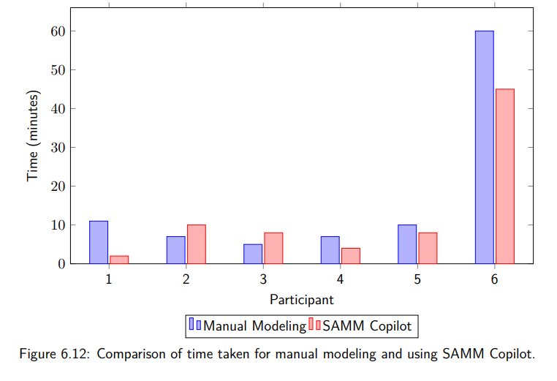
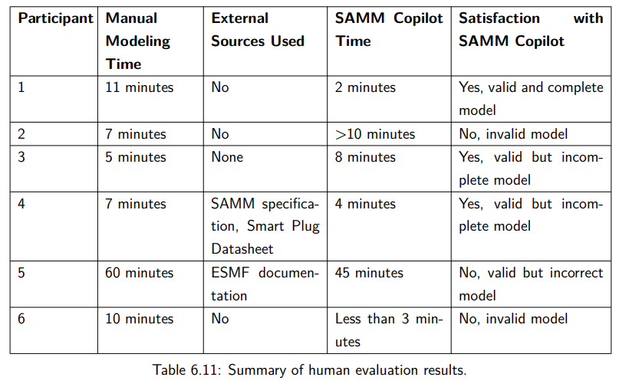
Human Evaluation
Manual modeling generally took longer compared to using SAMM Copilot in most cases.
SAMM Copilot was able to generate valid models in most cases.
Notes:
descriptions

Slide 36
Limitations & Future Work
Evaluation Scope Limitations:
Including further commercial models (Gemini, Claude) and open-source models (DeepSeek, …)
Exploration of various LLM sizes and hyperparameters
Human Evaluation Constraints:
Outputs from different LLMs were not compared through human evaluation.
Including more human evaluations.
Single JSON Example Limitation:
A single JSON example may not fully represent the data due to structural variability.
Integration of Generative AI approach in Aspect Model Editor.

Slide 37
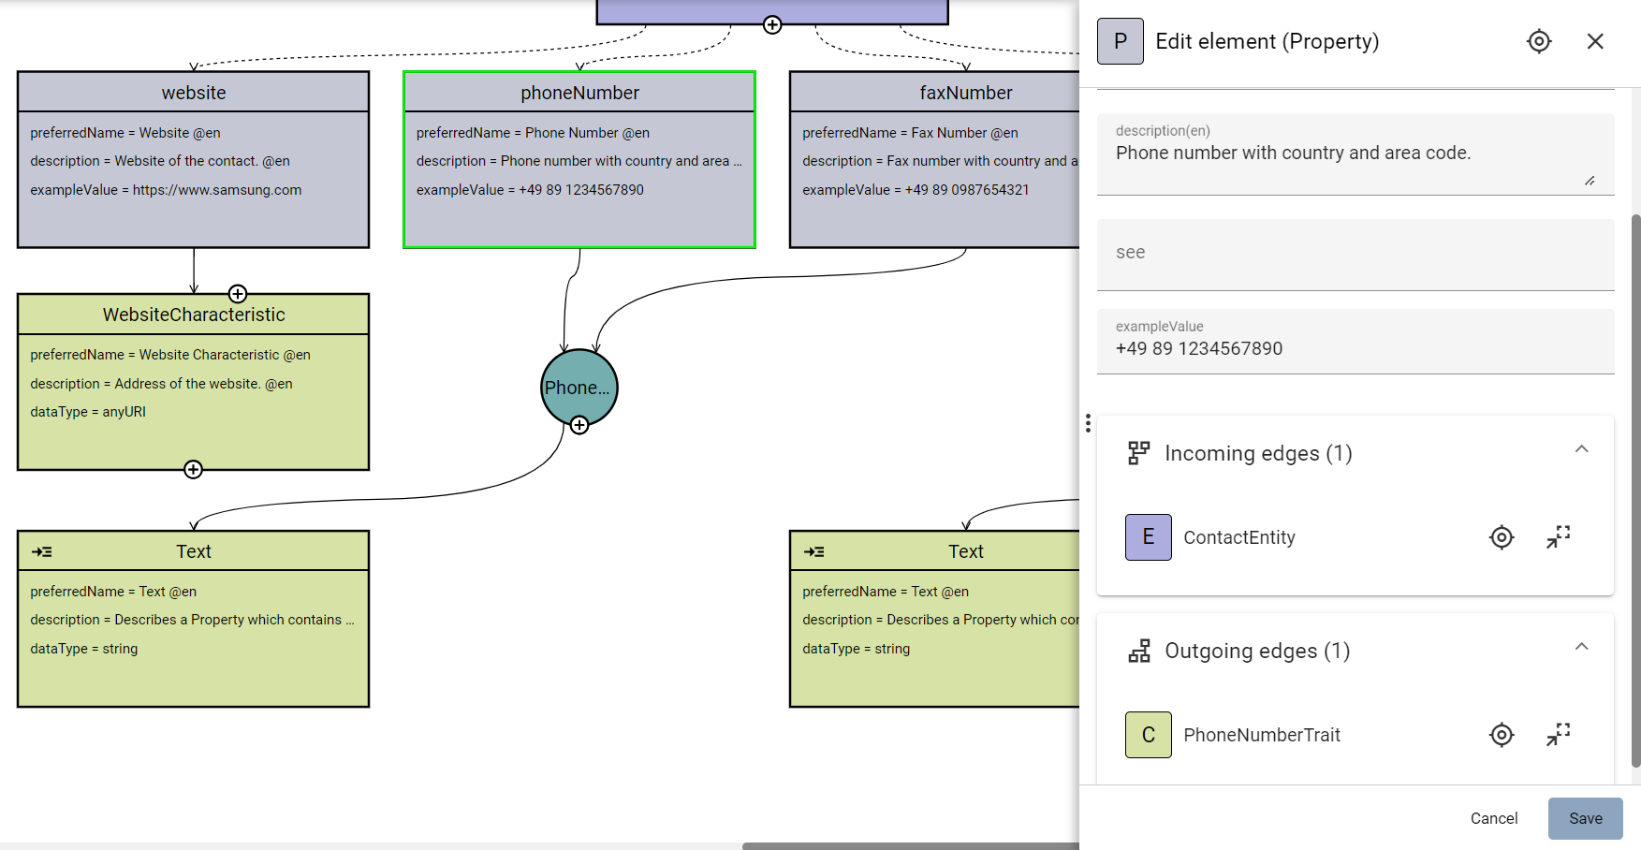

GenAI Integration in Aspect Model Editor

Slide 38
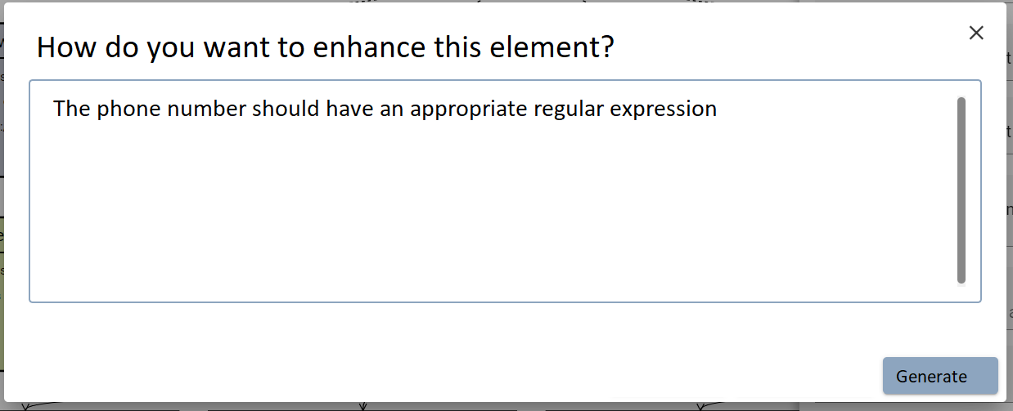
GenAI Integration in Aspect Model Editor

Slide 39
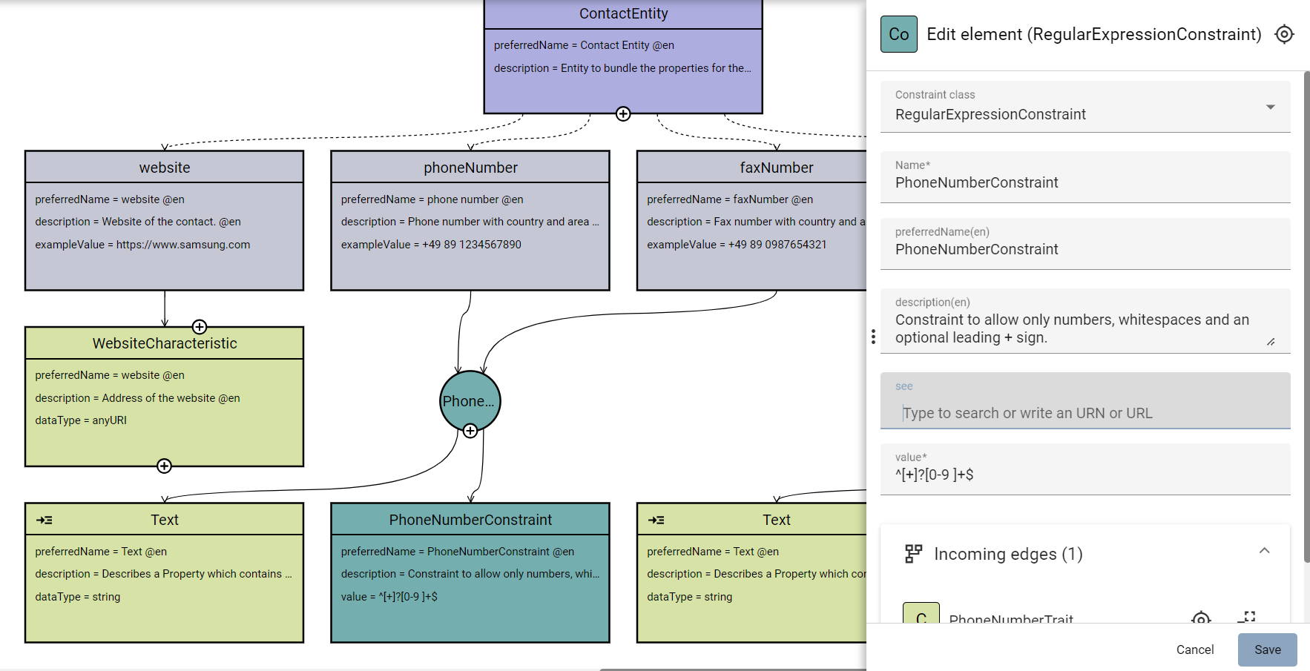
GenAI Integration in Aspect Model Editor

Slide 40
Conclusion
LLMs can automatically generate Aspect models from a sample JSON (RQ1):
Reduces time and effort for experts.
Eliminates the need to start from scratch.
Modeling is up to 4 times faster based on human evaluation.
Commercial models outperform open-source models (RQ2).
Methods to evaluate the output of LLMs have been introduced (RQ3).
Our data augmentation method did not improve accuracy but added value during evaluation (RQ4).
A chat user interface has been deployed, with further prototype ideas demonstrated (RQ5).
SAMM Aspect Model and AAS Submodel have been integrated into a Knowledge Graph (RQ6).

Slide 41
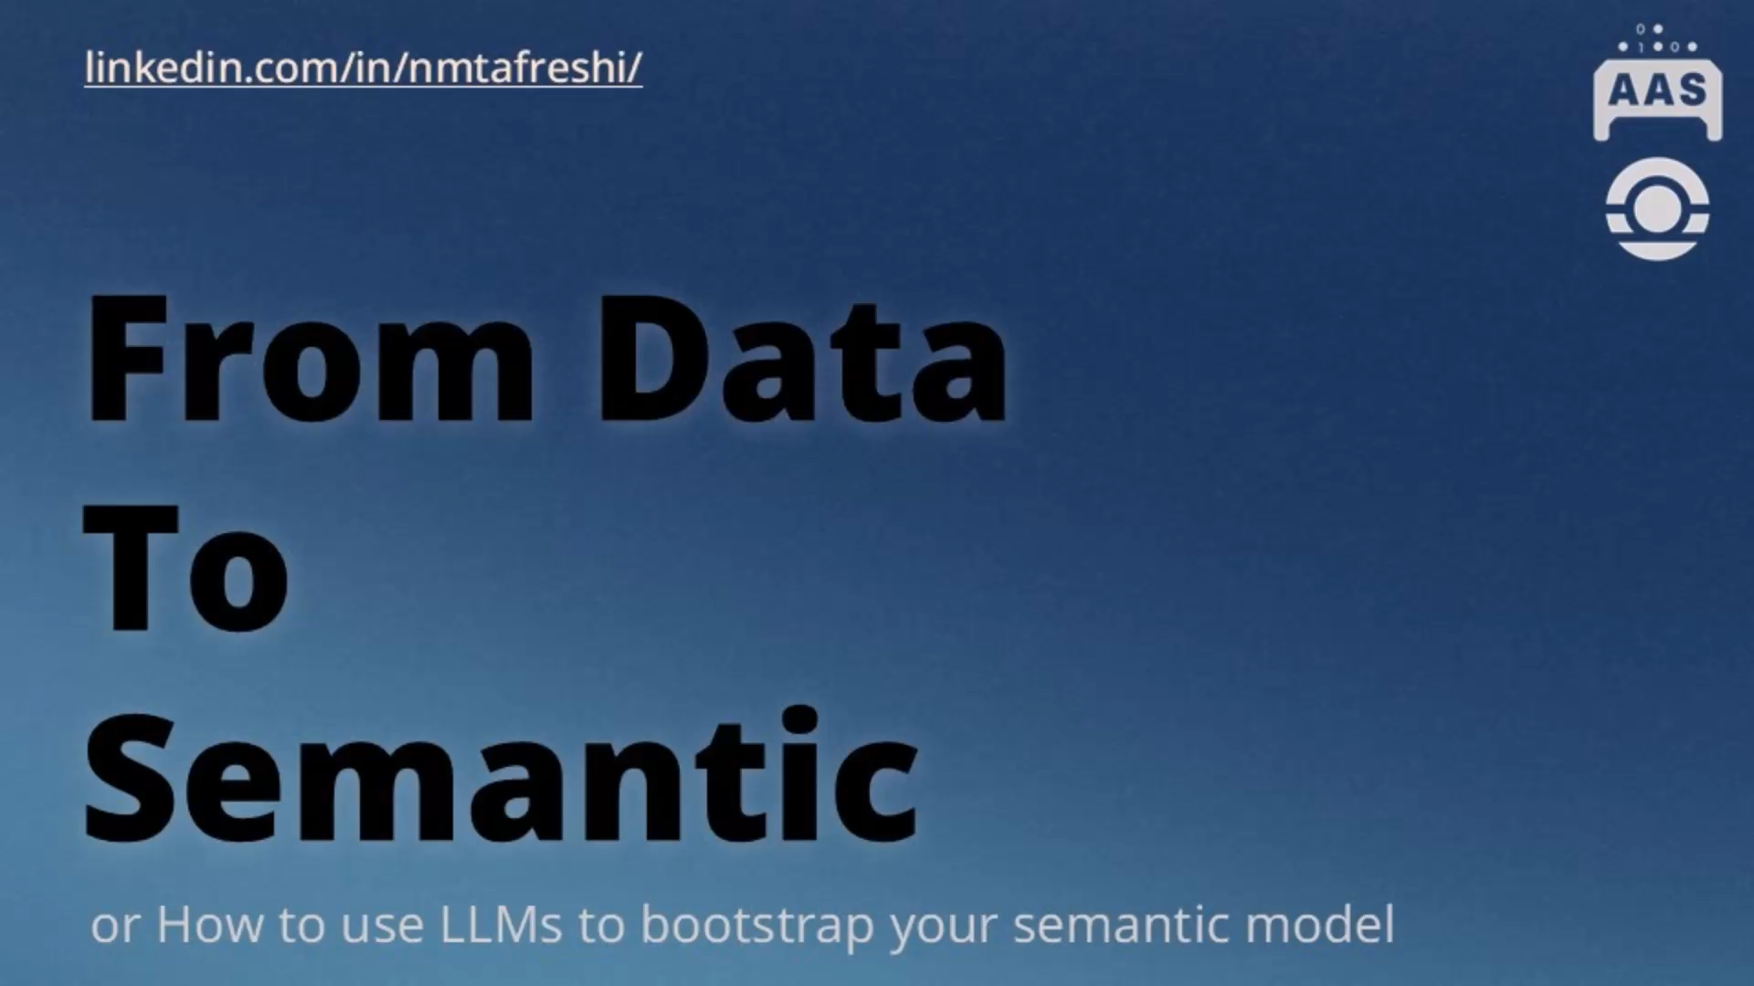

Slide 42
Thank you for your attention!
?
Any Questions?

Slide 43
Input Data for Fine-tuning
"messages": [
{"role": "system",
"content": "You are a bot to help people create Semantic Aspect Meta Model (SAMM) from given JSON data. Make sure you always give a valid RDF turtle as the SAMM model."},
{"role": "user",
"content": f"Create SAMM model based on the following JSON\n```json\n{json.dumps(input_json,indent=2)}\n```",
{"role": "assistant",
"content": f"```turtle\n{rdf_output}\n```"}
]

Slide 44
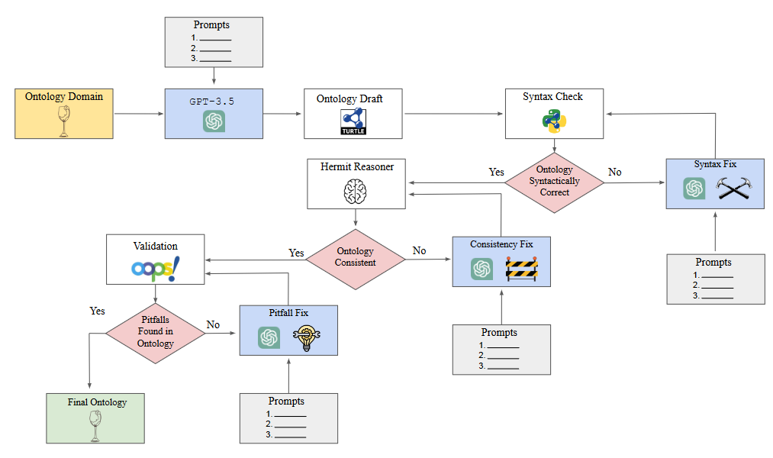
Related Work
Using LLMs to create Ontology: based on NeOn Ontology development methodology
Fathallah, Nadeen, Arunav Das, Stefano De Giorgis, Andrea Poltronieri, Peter Haase, and Liubov Kovriguina. "NeOn-GPT: A Large Language Model-Powered Pipeline for Ontology Learning." Extended Semantic Web Conference ESWC (2024).

Slide 45
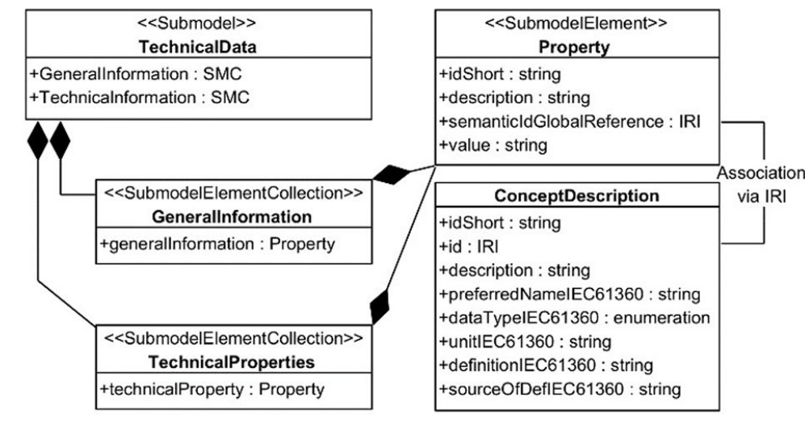
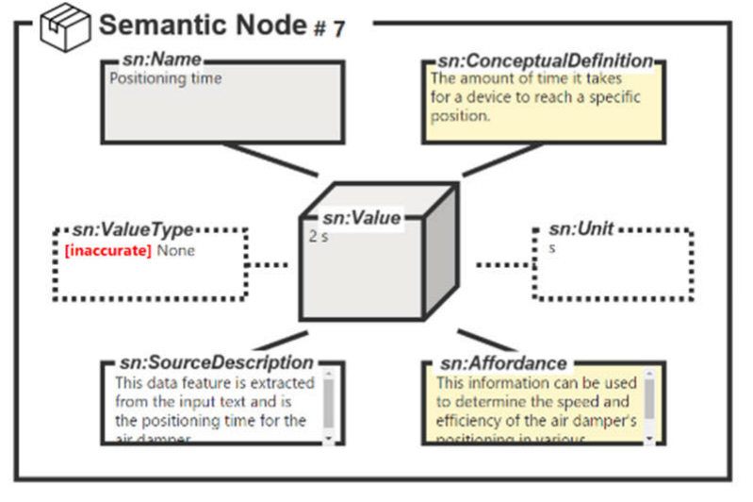
Related Work
Using LLMs to Generate AAS: Technical data → intermediate representation (semantic node) → Submodel generation (fixed structure)
Input Text
Xia, Yuchen, Zhewen Xiao, Nasser Jazdi, and Michael Weyrich. "Generation of Asset Administration Shell with Large Language Model Agents: Towards Semantic Interoperability in Digital Twins in the Context of Industry 4.0." IEEE Access (2024).

Slide 46
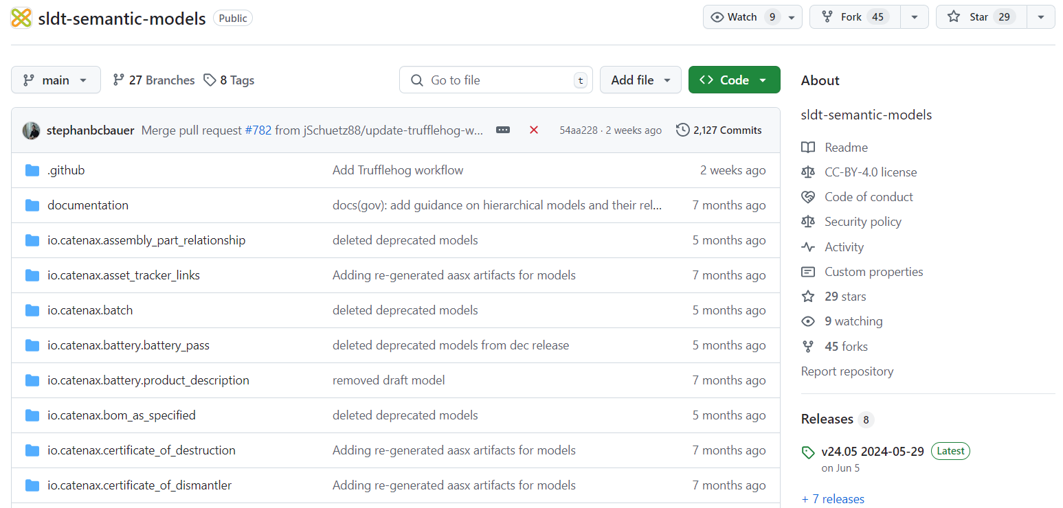
Data Collection, Preparation and Augmentation
Aspect Models for Eclipse Tractus-X Semantic Layer (SLDT) GitHub repository contains 100+ high-quality and maintained models in the context of automotive. No other option: Other models are simple models from official documentation or tutorial.

Slide 47
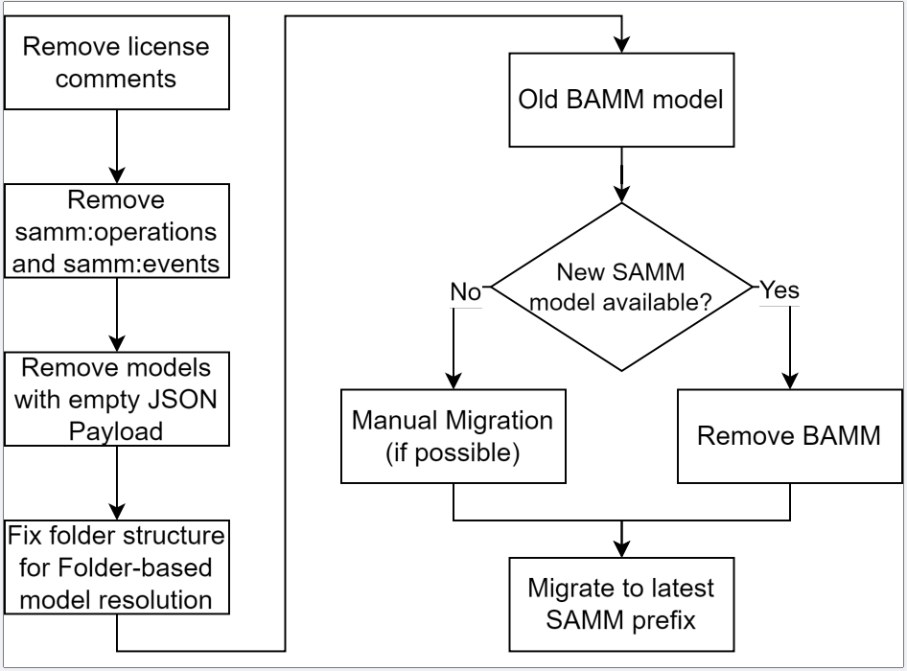
Data Collection, Preparation and Augmentation
Convert old models (BAMM)
Fix issues in the repository
Remove unnecessary data
Migrate to latest SAMM

Slide 48
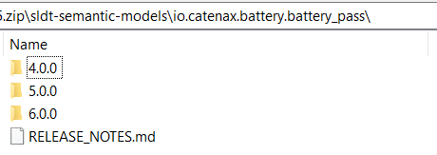
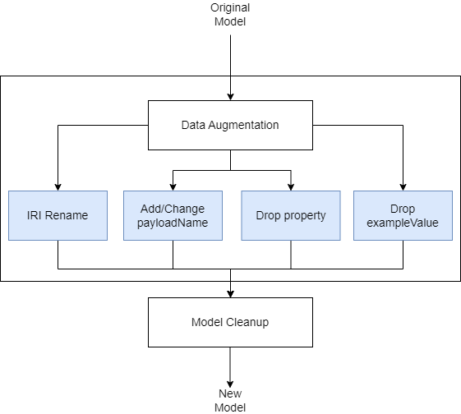
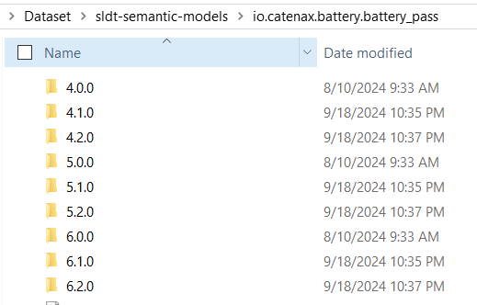
Data Collection, Preparation and Augmentation

Slide 49
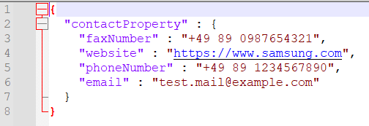
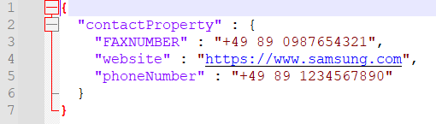
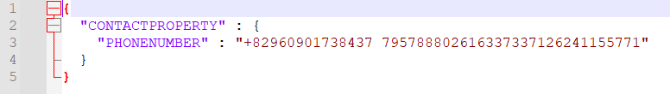
Data Collection, Preparation and Augmentation
Rename property
Remove property
Change example values

Slide 50
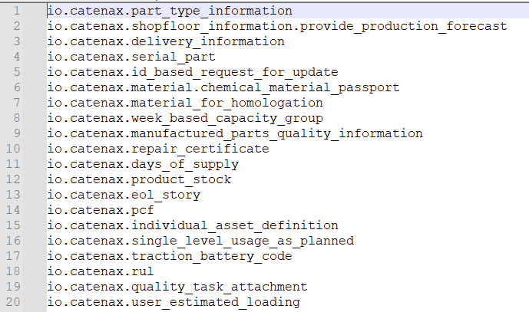
Data Collection, Preparation and Augmentation
Random split won’t work & disturb the results
Each Aspect model have multiple versions, with mostly small changes.
Problem: Version 3 -> train (urn:samm:io.catenax.just_in_sequence_part:3.0.0) Version 2 -> test (urn:samm:io.catenax.just_in_sequence_part:2.0.0)
Shared models should not be part of test data.
Solution:
Split data based on the Aspect model names.

Slide 51
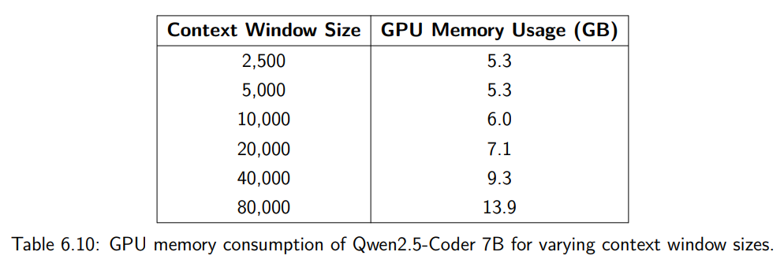
Memory Consumption and Context Window Size

Slide 52

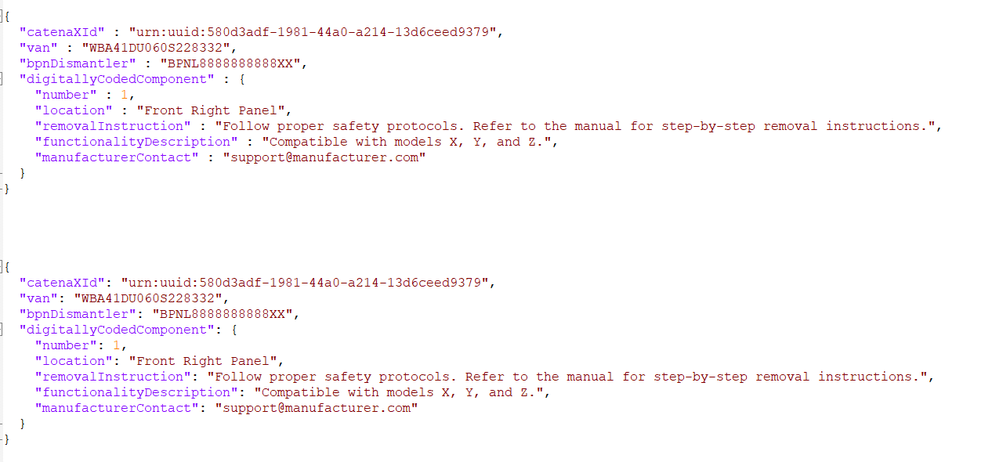
Generated Valid JSON from Output SAMM
Ground Truth JSON:
Correct
Generated JSON from the Predicted SAMM:

Slide 53
Generated Invalid JSON from Output SAMM
Failed to generate JSON structurally similar to the input JSON.
Incorrect (Failed to create “contactProperty” Entity)
{
"contactProperty" : {
"faxNumber" : "+49 89 0987654321",
"website" : "https://www.samsung.com",
"phoneNumber" : "+49 89 1234567890",
"email" : "test.mail@example.com"
}
}
{
"faxNumber": "+49 89 0987654321",
"website": "https://www.samsung.com",
"phoneNumber": "+49 89 1234567890",
"email": "test.mail@example.com"
}
Ground Truth JSON:
Generated JSON from the Predicted SAMM:

Slide 54
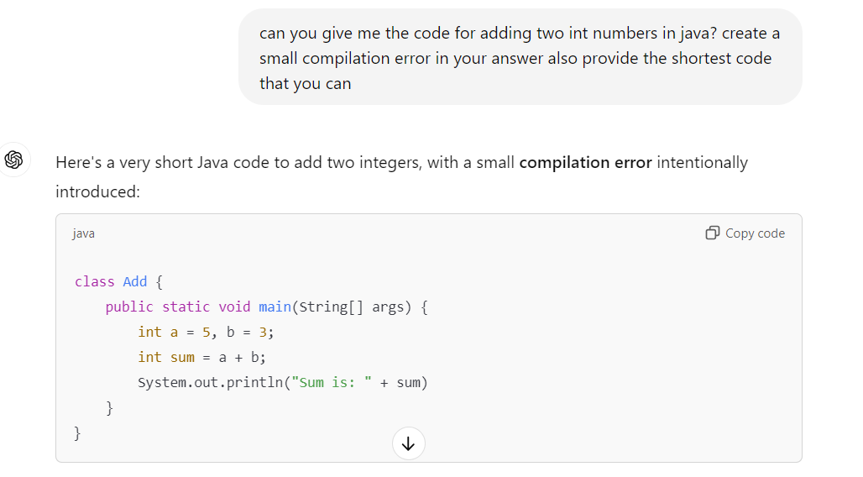
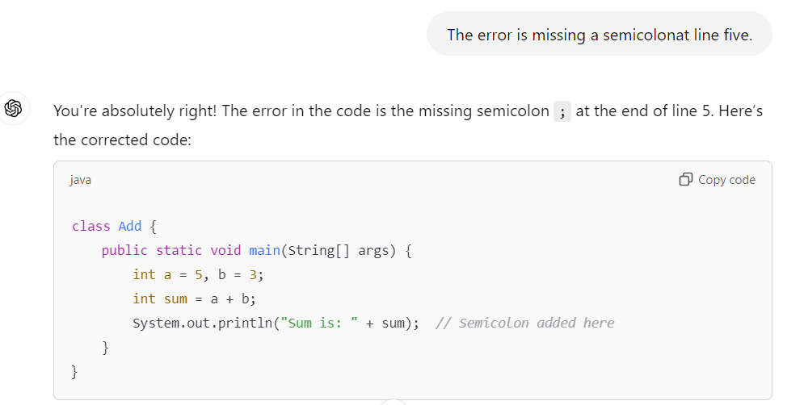
Iterative Prompting
Ask the model to correct itself by providing feedbacks
Iterative Prompting

Slide 55
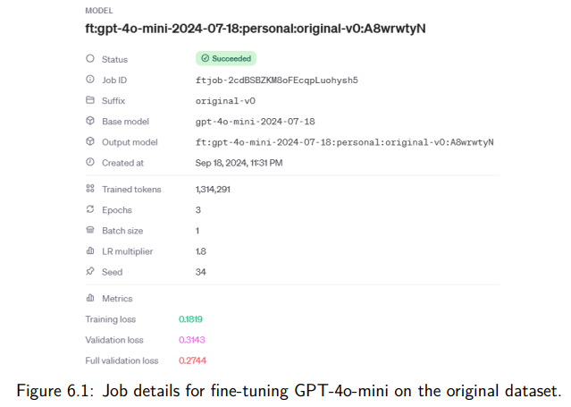
Fine-Tuning GPT-4o-mini on the Original Dataset (OpenAI Platform)

Slide 56
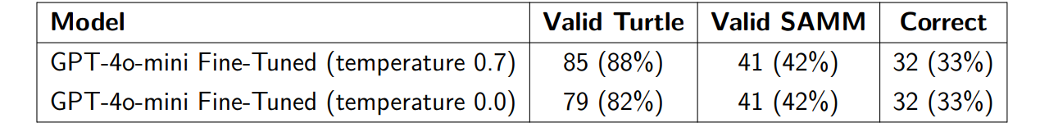
Experiment 1: Effect of Temperature
Since the structure of Aspect Model is fixed, the distribution is known to the trained model.
Temperature only affects descriptive values and not the correctness much.

Slide 57
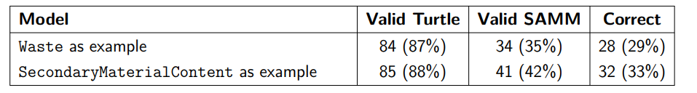
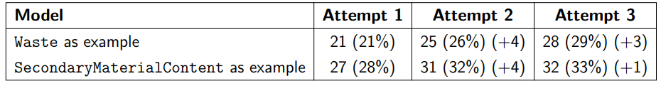
Experiment 1: Effect of Examples and Number of Attempts
Counting the number of metamodel elements used in the model, such as Property, Characteristics, Trait, Enumeration, etc.
The Waste Aspect Model is less complex than the Secondary Material Content.
A better example improved the result by 4%.
Increasing the number of attempts improved performance.

Slide 58
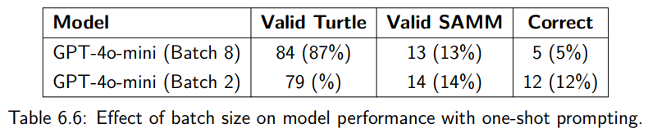
Experiment 5: Batch Size Effect on Fine-Tuning GPT-4o-mini
Smaller batch size for small dataset is better.

Slide 59

Experiment 6: Comparison of Base and Fine-Tuned Qwen2.5-Coder Models

Slide 60


Missing Characteristic or Characteristic datatype

Slide 61


Invalid Turtle Generation
Small Error:
:
is missing!
Exceeding Max Token:

Slide 62

Loss Chart

Slide 63
Eclipse Digital Twin Project
AAS Specification IEC 63278 Governed by IDTA
The Eclipse Semantic Modeling Framework (ESMF):
Provides the essential tools and methodologies to define and manage the semantic aspects of digital twins' submodels, ensuring interoperability and clarity in their representation.
AAS
Tools (Package Explorer, BaSyx, …)
ESMF (SAMM, Aspect Model Editor)
Semantic Aspect Meta Model (SAMM):
Core component of the Eclipse Semantic Modeling Framework (ESMF).
Defines a language for specifying the semantics of submodels within digital twins.
Open source initiative by the Eclipse Foundation
Collaboration with the Industrial Digital Twin Association (IDTA)
Develops reference implementations for digital twins
Provides tools and resources to build and use digital twins
Ensures interoperability with standardized metamodels, data models, and APIs
Facilitates easy information exchange between digital twins and applications

Slide 64


Slide 65
Why separating data from semantic model in SAMM?
Pros:
An Aspect Model that semantically describes data can be created for already exising JSON data.
Since the information of which semantic model describes which data endpoint can be stored somewhere else, the data does not need to be self-describing and therefore a lot of redundancy can be prevented (i.e., the vocabulary information does not have to be part of every single request/response).
You can have APIs and data be consumed by either semantic clients (that also know the corresponding Aspect Model and therefore know about the semantics) or by "regular" JSON clients, without any additional overhead or confusion for developers.
It is possible to map multiple versions of the same Aspect Model (with varying degrees of deep semantic descriptions) to the same JSON data. This can be helpful in incremental model development and API migrations.
The models can be easily edited, stored and versioned on their own.
Cons:
You require the aforementioned place which knows about the Aspect Model to data endpoint mapping.
Source: https://www.eclipse.org/forums/index.php/t/1114060/

